Slide 1
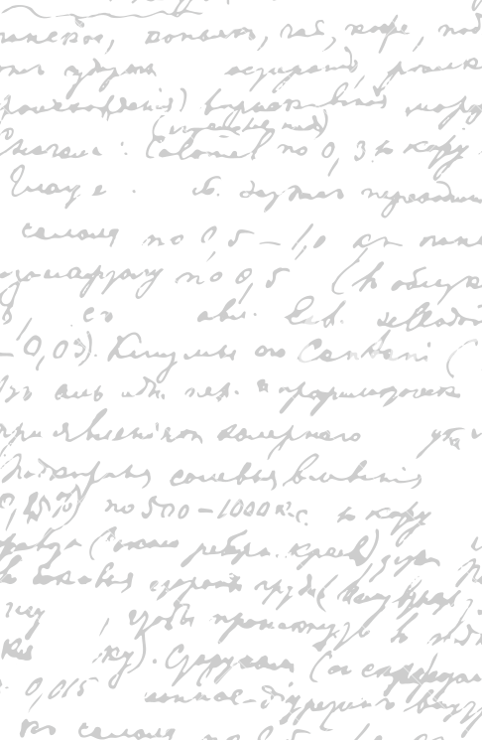

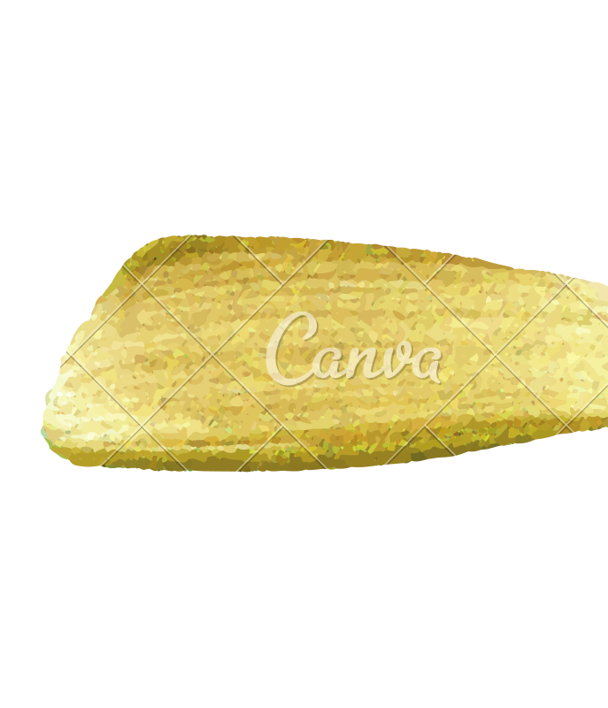

Ming Wu (Andrew) 2133861w
Laser Mate!
Project Supervisor Meeting 12
5 February 2021

Slide 2
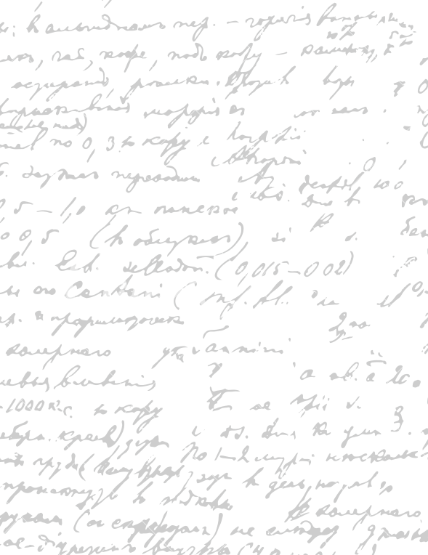



Start Recording

Slide 3
Main Topics
Evaluate dissertation parts
Evaluate digital prototype

Slide 4
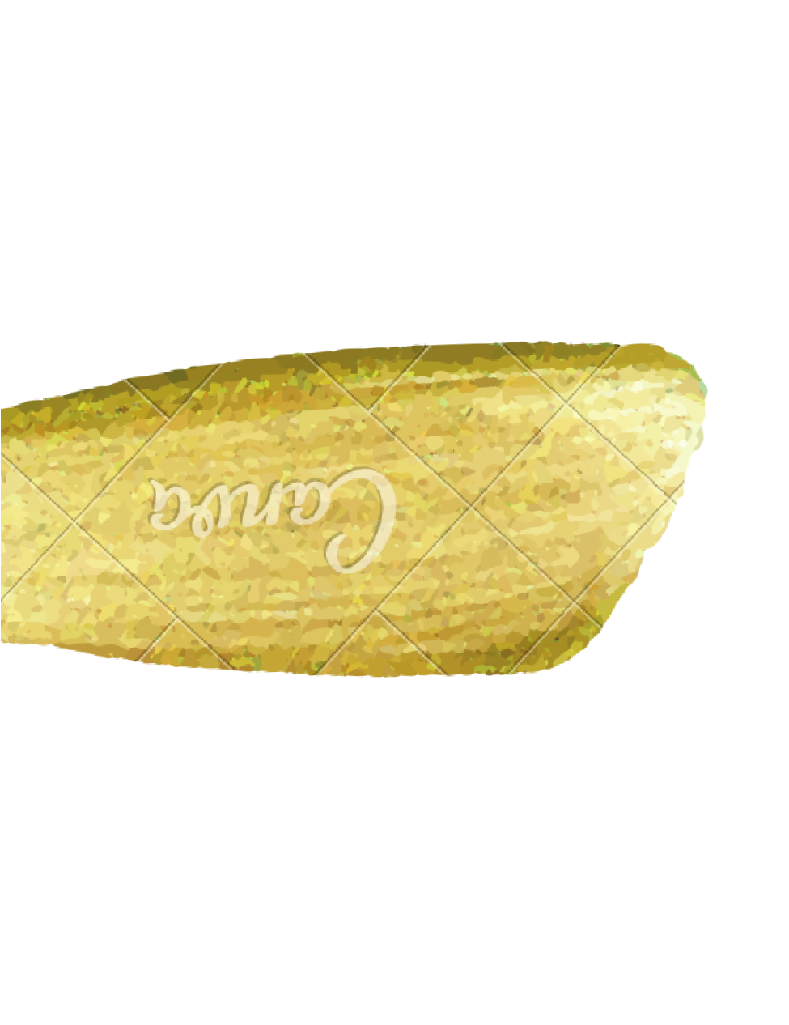
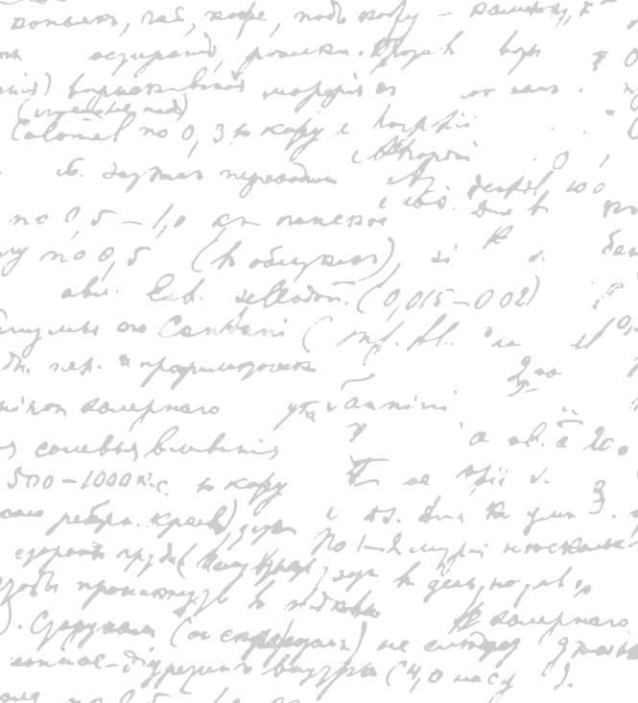

Evaluate Dissertation
Parts
Workflow
- Go through the design principles in XD. Ask Stephen whether to include design principles in the dissertation
Project Development Strategy
Design Principles

Slide 5
2. Evaluate and Refine Current
Digital Prototype
For each software part,
- describe why it is a good design; suggest areas of improvement, consider alternative designs.
Colour Scheme/ Contrast
Font Size/ Style
Way of presentation (order of information display)
Word Choice/ image
Icon shape/ size
Spacing/ Proximity between words/images
Software process (how to navigate between pages)
Necessity (whether this part must be present)
What can be added and why
What can be deleted and why
What can be improved and how/ identify the solutions

Slide 6
End

